Slide 1
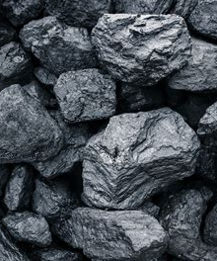
Non-renewable Resources – Page 1
Imagine a world overflowing with many types of energy. It can seem challenging to understand everything. But there are people, energy experts, who make it easier for us by sorting these energies into groups. Picture this like a massive piggy bank of energy, where each kind of energy is a unique, special coin. Using a sorting system, similar to how you might sort coins into different jars, these experts classify energy into categories such as fossil fuels, nuclear energy, or geo-thermal energy. By doing this, they can study and understand the different types of energy that we use in our everyday lives much better.
How is the world of energy compared to a piggy bank? ___________________________________________________________________
How do experts sort these energies into different groups? ___________________________________________________________________
What are some examples of energy groups mentioned in the passage? ___________________________________________________________________
Firstly, let's delve deeper into coal, a solid fossil fuel that was formed over millions of years from decomposed plant materials. Like a captivating history book sitting on the shelves of our energy library, coal narrates an ancient tale about the Earth's prehistoric past, explaining how humans have utilized it for heat and electricity, and highlighting its influential role in powering the Industrial Revolution. Despite its historical importance, once we burn coal for energy, it's gone forever, reinforcing the fact that it's a non-renewable energy source.
What is coal? ___________________________________________________________________
How does the passage compare coal to a history book? ___________________________________________________________________
Why is coal considered non-renewable? ___________________________________________________________________

Slide 2
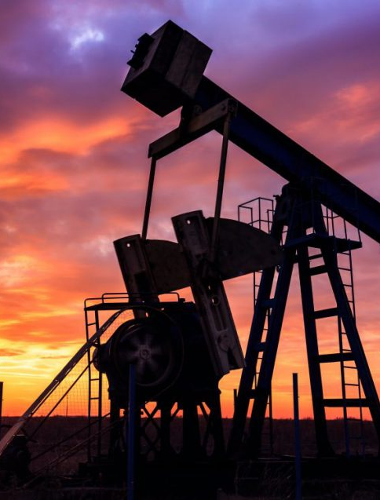
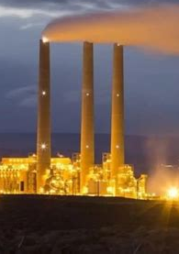
Non-renewable Resources – Page 2
Secondly, imagine oil, a liquid fossil fuel that oozed from ancient life forms buried deep within the Earth's crust. Comparable to an intense adventure novel, the story of oil takes us on a journey from its formation under extreme heat and pressure, through the complex processes of drilling and refining, and on to its diverse uses in our modern world. However, like the thrilling plot of an adventure novel, once oil is extracted and used, we cannot go back and start again, reinforcing its status as a non-renewable energy source.
How is oil? __________________________________________________________________
How does the passage compare oil to an adventure novel? __________________________________________________________________
Why is oil considered non-renewable? __________________________________________________________________
Finally, consider natural gas, a gaseous fossil fuel often found alongside oil deposits. It's like a mystery book, concealing many secrets about our planet's history and our energy consumption patterns. Once extracted through intricate drilling processes, natural gas has a multitude of uses in our daily lives, including heating, cooking, and electricity generation. However, like the riveting plot of a mystery novel, once the natural gas is used, the story ends and can't be revisited, underlining its non-renewable nature.
What is natural gas? __________________________________________________________________
Where is natural gas often found? __________________________________________________________________
What are some of the uses of natural gas? __________________________________________________________________

